Slide 1
Recommender System for User Item Interactions
By
Sai Harshitha Peddi-018222087
Hemanth Sai Kosari-018223049
Bhargava Phaneendra Kumar Suryadevara-018176379

Slide 2
Motivation
Why this project matters
Most real-world platforms (YouTube, Spotify, Amazon) rely heavily on implicit feedback (clicks, views, listens).
Unlike explicit ratings, implicit interactions do not directly tell us preference strength.
This makes the learning problem harder and requires specialized algorithms.
Project Motivation
This project evaluates three fundamentally different recommendation approaches - LightGCN, ALS, and Collaborative Filtering—each implemented independently to understand how contrasting modeling strategies behave on the same implicit-feedback dataset.
By testing them under identical conditions, we can fairly compare how well each method handles sparsity, missing data, and the absence of explicit ratings.
Our objective
Build a top-20 recommendation system using implicit interactions.
Analyze which modeling approach works best on our dataset.

Slide 3
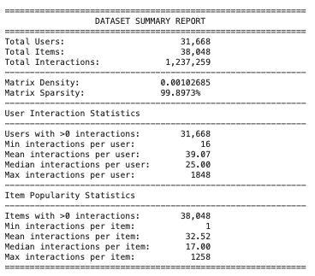
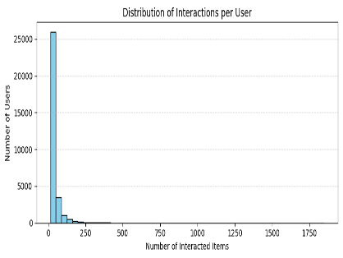
Dataset Overview:-
31,668 users • 38,048 items • 1.23M interactions, but 99.9% sparse — most user–item pairs have no interaction.
Users interact with very few items, while a small number of items are extremely popular → long-tail distribution.

Slide 4
Algorithms Selected
LightGCN
ALS
CF
LightGCN is a lightweight graph-based collaborative filtering model. It was selected because it effectively captures multi-hop user–item relationships while remaining computationally efficient. It is particularly well-suited to sparse datasets due to its propagation-based embedding refinement.
Why selected:
Designed specifically for implicit-feedback recommendation
Performs well on sparse user–item matrices
Scales smoothly to large datasets
Provides strong baseline performance without heavy neural components
ALS (Alternating Least Squares) is a latent factor model used for implicit-feedback recommendation. ALS is efficient on large, sparse datasets and offers stable, predictable performance. It generalizes beyond surface-level similarities by uncovering hidden preference patterns in the interaction matrix.
Why selected:
Well-suited for implicit-feedback data (confidence-weighted factorization)
Handles large, sparse user–item matrices efficiently
Learns latent behavioral patterns beyond direct co-occurrences
Provides strong, stable performance with straightforward tuning
High sparsity → few common items → similarity is weak or unreliable. Implicit feedback noise → equal weight for all interactions leads to poor neighbor matching. Cold-start issues for users/items with few interactions. Cannot learn deep representations — relies only on surface-level similarity.
Why selected:
It matches the dataset’s structure (pure implicit, no item features).
It provides interpretable baselines.
It allows to test both classical similarity models and modern approaches.
It helps analyze how simple vs. sophisticated approaches behave under sparsity

Slide 5
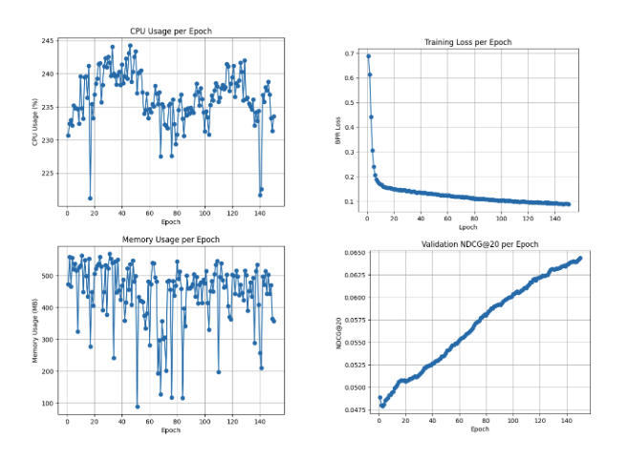
LightGCN
Approach:
Built a user–item graph from interactions
Performed layer-wise embedding propagation (neighbors average)
Combined embeddings from all layers
Predicted relevance using a dot product
Trained using BPR loss with positive/negative sampling
Evaluated using NDCG@20
Tweaks Tried:
v1: Base LightGCN
v2: Better regularization & propagation tuning
v3 + Popularity (α = 0.8): Added popularity prior (slightly worse)
v4 (Best): Optimized LR, sampling, and embedding size
Top NDCG@20 = 0.0349
Model Variant / Submission | File Name | NDCG@20 (on 50%)
LightGCN v4 (Best-performing) | submission_lgcn4.txt | 0.0349
LightGCN with popularity blend (α = 0.8) | submission_lgcn3_alpha_0.8.txt | 0.0322
LightGCN v2 | submission-lgcn-2.txt | 0.0305
LightGCN v1 | submission-lgcn.txt | 0.0284
LightGCN + popularity baseline | submission__lgcn3pop.txt | 0.0106

Slide 6
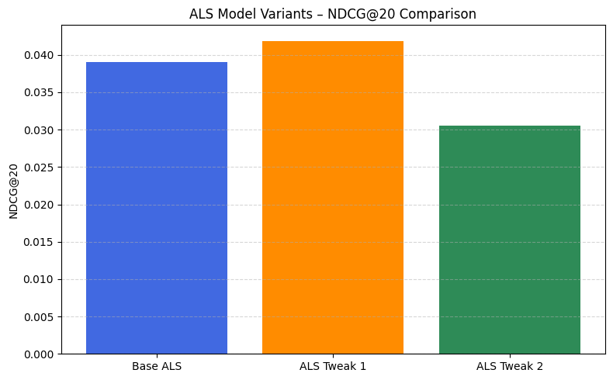
Alternating Least Squares (ALS)
ALS is a latent factor model that learns user and item embeddings from implicit feedback using alternating optimization.
Preprocessing included ID mapping, rare-item filtering, building a CSR sparse matrix (~31K × ~38K), and applying a per-user 90/10 train–validation split. A user_items dictionary was created to track seen items, and BM25 weighting was used only for the ALS Tweak 2 variant.
Trained three configurations by varying latent factors (64/96/128), regularization, iterations (20–30), and using BM25 weighting for one variant.
ALS Tweak 1 (128 factors, reg=0.05) achieved NDCG@20 ≈ 0.0419, the highest score among all ALS variants and all models overall.
ALS Variant | Configuration | What we Changed | NDCG
Base ALS | 64 factors, reg=0.01, 20 iterations, α=40 | Default Setup | 0.039
ALS Tweak1 | 128 factors, reg=0.05, 30 iterations, α=40 | Increased model capacity | 0.0419
ALS Tweak 2 | 96 factors, reg=0.03, 25 iterations, α=20, BM25 weighting | Normalized item popularity | 0.0305
Notes:
Now I’ll talk about the ALS model. ALS is a latent factor method that learns embeddings for users and items from implicit feedback. It’s a good fit for our data because it scales well on large, sparse matrices.
For preprocessing, we mapped user and item IDs to integers, removed very rare items, built a CSR sparse matrix, and used a 90/10 train–validation split. For one variant we also applied BM25 weighting to reduce the effect of very popular items.
We trained three ALS configurations by changing the number of factors, regularization, iterations, and whether BM25 was used. As you can see in the table and bar chart, ALS Tweak 1 with 128 factors gave the best NDCG@20 of about 0.0419, which was the highest score across all our models. The BM25 version trained stably but ended up with slightly lower NDCG. Overall, ALS turned out to be the strongest model in our project.”

Slide 7
Collaborative Filtering
Recommends items based on similarity between users or items. Core idea: “Users who interacted with similar items will have similar preferences.”
Item–Item CF → recommends items similar to those the user already consumed. Build item–user matrix ; Compute cosine similarity between items ; User profile = sum of their interacted item vectors Rank items by similarity to user profile Variants: Sum profile (best), Mean profile, IDF-weighted profile
Model-based CF Reduce user–item matrix into k latent dimensions Variants: 32 factors, 64 factors, 128 factors Results: Best validation NDCG → 128 dims
Model Variant | Result | Comments
Item–Item CF (Cosine, Sum & Mean Profiles) | 0.04321 | Both profiles perform identically because cosine similarity depends on vector direction, not magnitude. This makes cosine the strongest and most stable CF variant.
Item–Item CF (Cosine, IDF-Weighted) | 0.027495 | Down-weighting popular items removed meaningful collaborative signal, leading to slightly weaker performance.
Truncated SVD (32 Components) | 0.022373 | Lower-dimensional embedding underfits interactions.
Truncated SVD (64 Components) | 0.023711 | Best SVD variant; good balance between variance captured and overfitting.
Truncated SVD (128 Components) | 0.026600 | Higher dimension introduces noise and does not improve ranking.

Slide 8
Comparison of Models
LightGCN vs. ALS
While LightGCN effectively captured multi-hop user–item relationships, ALS achieved better overall prediction on this dataset due to its strong latent factor modeling.
ALS handled the dataset’s extreme sparsity more robustly by leveraging confidence-weighted matrix factorization, resulting in more stable and consistent embeddings.
LightGCN benefited from graph propagation but was more sensitive to hyperparameters and required deeper tuning, whereas ALS converged faster and produced higher-quality recommendations with simpler optimization.
Overall, although LightGCN is efficient and modern, ALS outperformed it on this dataset in terms of ranking quality and generalization.
Collaborative Filtering vs. ALS
Handling Sparsity: CF struggles when users have few overlapping interactions, while ALS learns latent factors and performs well even in extremely sparse datasets.
Model Capability: CF relies on direct similarity, which is simple but limited; ALS captures deeper hidden patterns by factorizing the entire user–item matrix.
Accuracy: ALS achieved significantly higher NDCG@20 in our experiments, whereas CF produced the lowest scores due to sparse co-occurrence.
Scalability & Stability: ALS scales efficiently and converges reliably on large datasets, while CF becomes less reliable and more sensitive to noise as sparsity increases.

Slide 9
Conclusion
The comparison of LightGCN, ALS, and Collaborative Filtering shows that each method brings different strengths to handling sparse implicit-feedback data, with performance depending strongly on how well the model aligns with the dataset’s structure.
ALS achieved the best overall results, offering stable convergence, effective handling of sparsity, and strong ranking performance due to its confidence-weighted matrix factorization approach.
LightGCN captured multi-hop user–item relationships efficiently but was more sensitive to hyperparameter choices and required deeper tuning to match ALS performance.
Collaborative Filtering provided a simple and interpretable baseline, but its neighborhood-based assumptions limited its ability to capture deeper user–item dependencies in highly sparse environments.
Things That Didn’t Work Well
Jaccard similarity - underperformed Too few overlapping users → weak similarity signal Much slower than cosine on large item sets
Over-normalization harmed performance
Early versions underperformed Initial LightGCN v1/v2 variants were weaker until proper tuning
High latent dimensions introduced noise Increasing factors beyond optimal size did not improve results

